Slide 1
Neuronal Dynamics: Computational Neuroscience of Single Neurons
Nonlinear Integrate-and-Fire Model
Nonlinear Integrate-and-fire (NLIF)
- Definition
- quadratic and expon. IF
- Extracting NLIF model from data
- exponential Integrate-and-fire
- Extracting NLIF from detailed model
- from two to one dimension
- Quality of NLIF?
Week 1 and Week 4:
Nonlinear Integrate-and-fire Model
Wulfram Gerstner
EPFL, Lausanne, Switzerland

Slide 2
Neuronal Dynamics – Review: Nonlinear Integrate-and Fire
LIF (Leaky integrate-and-fire)
NLIF (nonlinear integrate-and-fire)
If firing:

Slide 3
Neuronal Dynamics – 1.4. Leaky Integrate-and Fire revisited
I=0
I>0
LIF
If firing:
u
resting
repetitive
u
u
t
t
Notes:
The LIF is characterized by a linear differential equation.

Slide 4
Neuronal Dynamics – 1.4. Nonlinear Integrate-and Fire
Nonlinear
Integrate-and-Fire
I=0
I>0
NLIF
u
u
firing:
if u(t) = then

Slide 5
Nonlinear Integrate-and-fire Model
Spike emission
j
i
F
reset
I
NONlinear
if u(t) = then
Fire+reset
threshold

Slide 6
Nonlinear Integrate-and-fire Model
I=0
I>0
u
u
Quadratic I&F:
NONlinear
if u(t) = then
Fire+reset
threshold

Slide 7
Nonlinear Integrate-and-fire Model
I=0
I>0
u
u
Quadratic I&F:
exponential I&F:
if u(t) = then
Fire+reset

Slide 8
Neuronal Dynamics: Computational Neuroscience of Single Neurons
Nonlinear Integrate-and-Fire Model
Nonlinear Integrate-and-fire (NLIF)
- Definition
- quadratic and expon. IF
- Extracting NLIF model from data
- exponential Integrate-and-fire
- Extracting NLIF from detailed model
- from two to one dimension
Week 1 and Week 4:
Nonlinear Integrate-and-fire Model
Wulfram Gerstner
EPFL, Lausanne, Switzerland

Slide 9
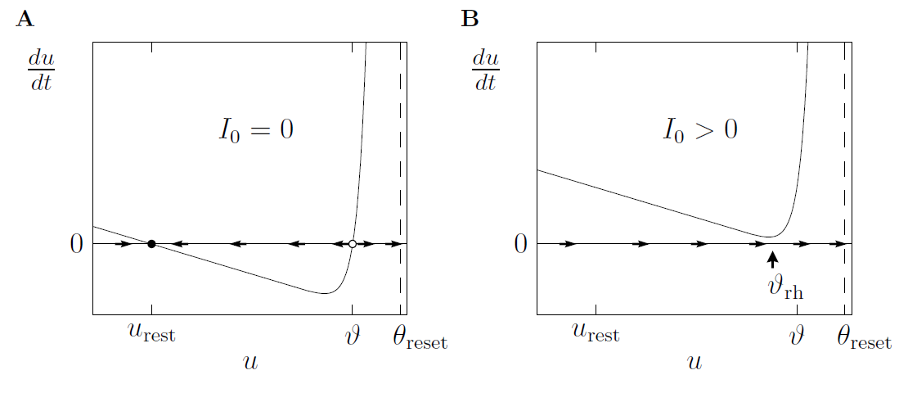
Neuronal Dynamics – Review: Nonlinear Integrate-and-fire
See:
week 1,
lecture 1.5
What is a good choice of f ?

Slide 10
Neuronal Dynamics – Review: Nonlinear Integrate-and-fire
(1)
(2)
What is a good choice of f ?
(i) Extract f from data
(ii) Extract f from more complex models

Slide 11
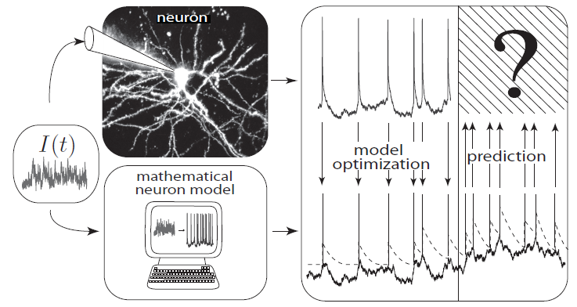
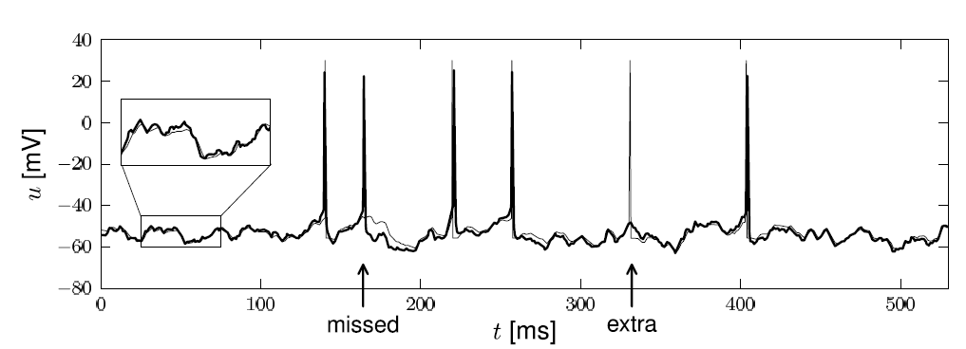
Neuronal Dynamics – 1.5. Inject current – record voltage
Notes:
What is a good neuron model? Would the nonlinear integrate-and-fire model be good?

Slide 12
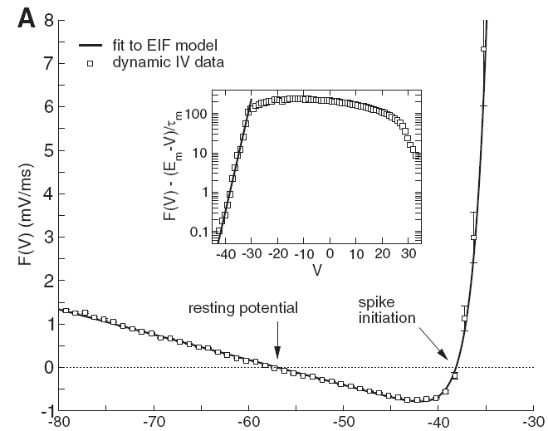
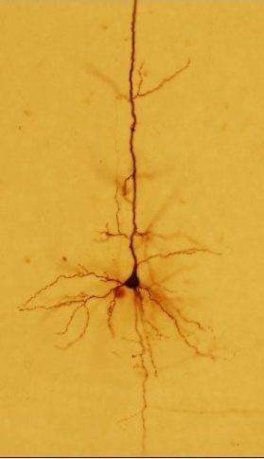
Neuronal Dynamics – Inject current – record voltage
voltage
I(t)
u [mV]
Badel et al., J. Neurophysiology 2008
Notes:
What is a good neuron model? Would the nonlinear integrate-and-fire model be good?

Slide 13
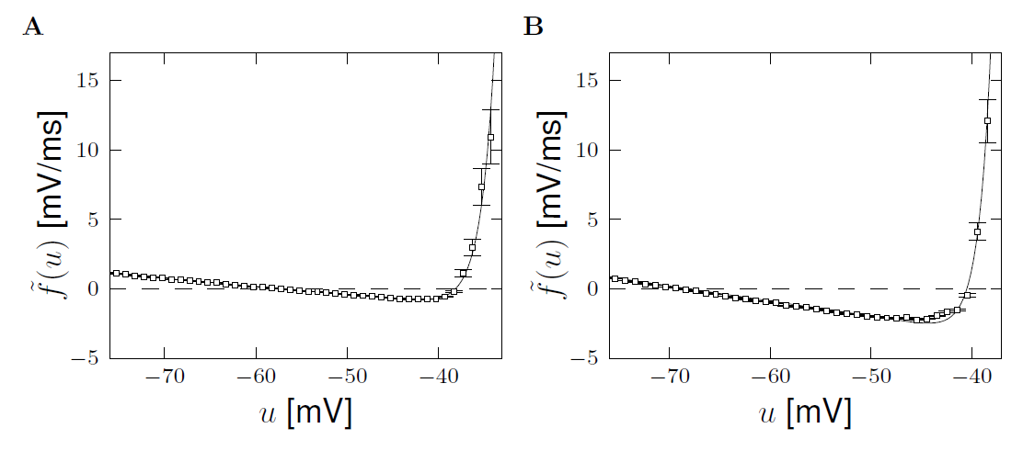
Neuronal Dynamics – Review: Nonlinear Integrate-and-fire
(i) Extract f from data
Badel et al. (2008)
Exp. Integrate-and-Fire, Fourcaud et al. 2003
Pyramidal neuron
Inhibitory interneuron
exponential
exponential
Badel et al. (2008)
linear
linear

Slide 14
Neuronal Dynamics – Review: Nonlinear Integrate-and-fire
(1)
(2)
Best choice of f : linear + exponential
BUT: Limitations – need to add
Adaptation on slower time scales
Possibility for a diversity of firing patterns
Increased threshold after each spike
Noise

Slide 15
Neuronal Dynamics: Computational Neuroscience of Single Neurons
Week 4 – part 5: Nonlinear Integrate-and-Fire Model
Nonlinear Integrate-and-fire (NLIF)
- Definition
- quadratic and expon. IF
- Extracting NLIF model from data
- exponential Integrate-and-fire
- Extracting NLIF from detailed model
- from two to one dimension
Week 1 and Week 4:
Nonlinear Integrate-and-fire Model
Wulfram Gerstner
EPFL, Lausanne, Switzerland

Slide 16
Neuronal Dynamics – 4.5. Further reduction to 1 dimension
2-dimensional equation
After reduction of HH
to two dimensions:
stimulus
slow!
Separation of time scales
w is nearly constant
(most of the time)

Slide 17
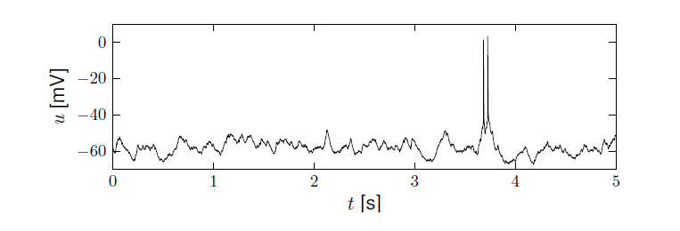
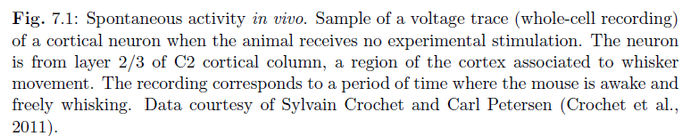
Neuronal Dynamics – 4.5 sparse activity in vivo
Spontaneous activity in vivo
awake mouse, cortex, freely whisking,
-spikes are rare events
-membrane potential fluctuates around ‘rest’
Crochet et al., 2011
Aims of Modeling: - predict spike initation times
- predict subthreshold voltage
Notes:
The aim of modeling is to say, when is the moment? When is one of these rare moments that the neuron is going to emit a spike?
Moreover why do we see these fluctuations? Why do we see this move up and down? Can we predict the subthreshold voltage with a neuron model?

Slide 18
Neuronal Dynamics – 4.5. Further reduction to 1 dimension
stimulus
w
Separation of time scales
I(t)=0
u
→ Flux nearly horizontal
Stable fixed point
Notes:
这里假设因为w的变化太慢了，所以把它当成一个常数看待。因此，slope field几乎可以当初横线。

Slide 19
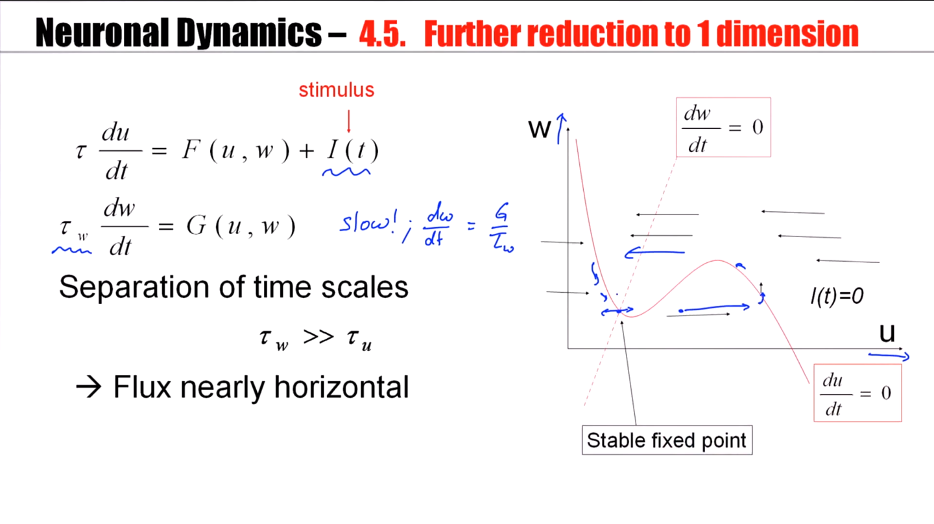
Notes:
如果起点是stable fix point，一个小的电流，电压就会左右振荡，而w近乎不变。
如果是大电流，就会repetitive firing

Slide 20
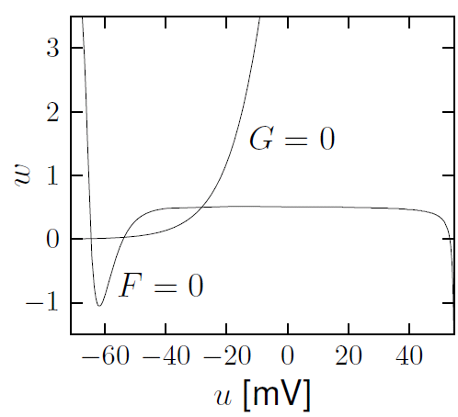
Neuronal Dynamics – 4.5. Further reduction to 1 dimension
Hodgkin-Huxley reduced to 2dim
Separation of time scales
Stable fixed point

Slide 21
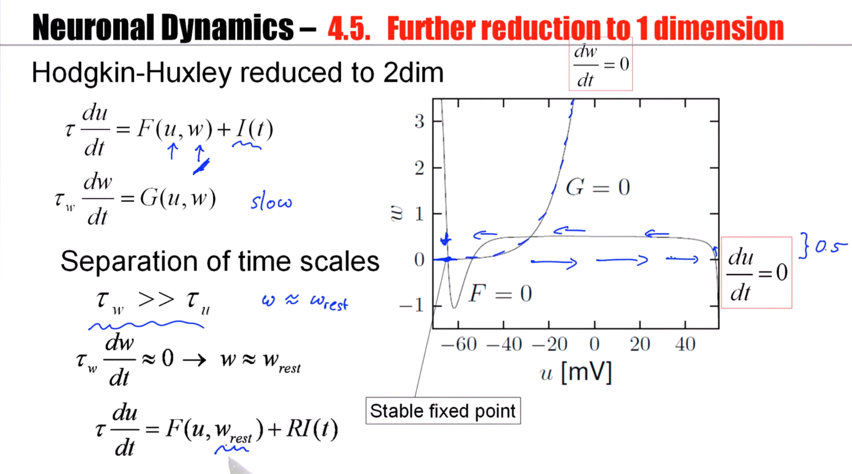
Notes:
如果是repetitive firing，w的变化也不超过0.5；
如果是action potential，我们认为w没有变化；
因此，我们就认为w就是w_resr。

Slide 22
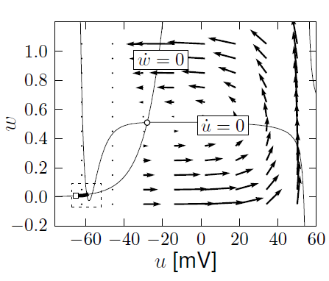
Neuronal Dynamics – Review: Nonlinear Integrate-and-fire
(i) Extract f from more complex models
A. detect spike and reset
resting state
Separation of time scales:
Arrows are nearly horizontal
Spike initiation, from rest
See week 3:
2dim version of
Hodgkin-Huxley
B. Assume w=wrest

Slide 23
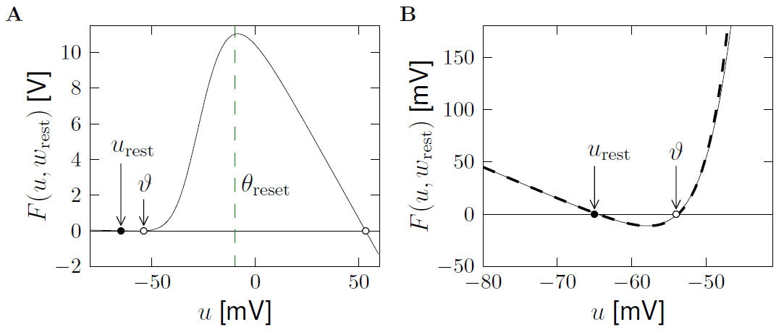
Neuronal Dynamics – Review: Nonlinear Integrate-and-fire
(i) Extract f from more complex models
exponential
linear
See week 4:
2dim version of
Hodgkin-Huxley
Separation of
time scales

Slide 24
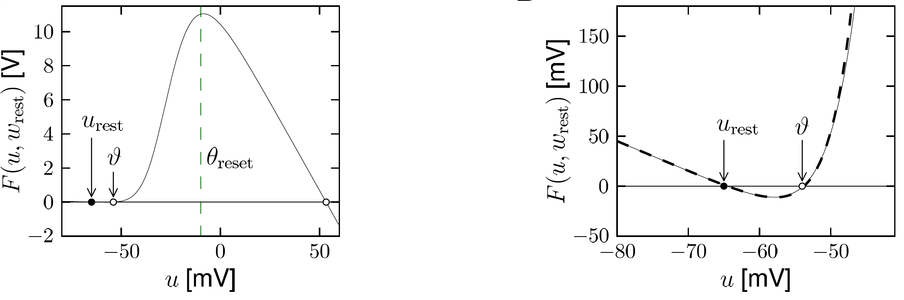
Neuronal Dynamics – 4.5. Nonlinear Integrate-and-Fire Model
Image: Neuronal Dynamics,
Gerstner et al.,
Cambridge Univ. Press (2014)
→ Nonlinear I&F (see week 1!)

Slide 25
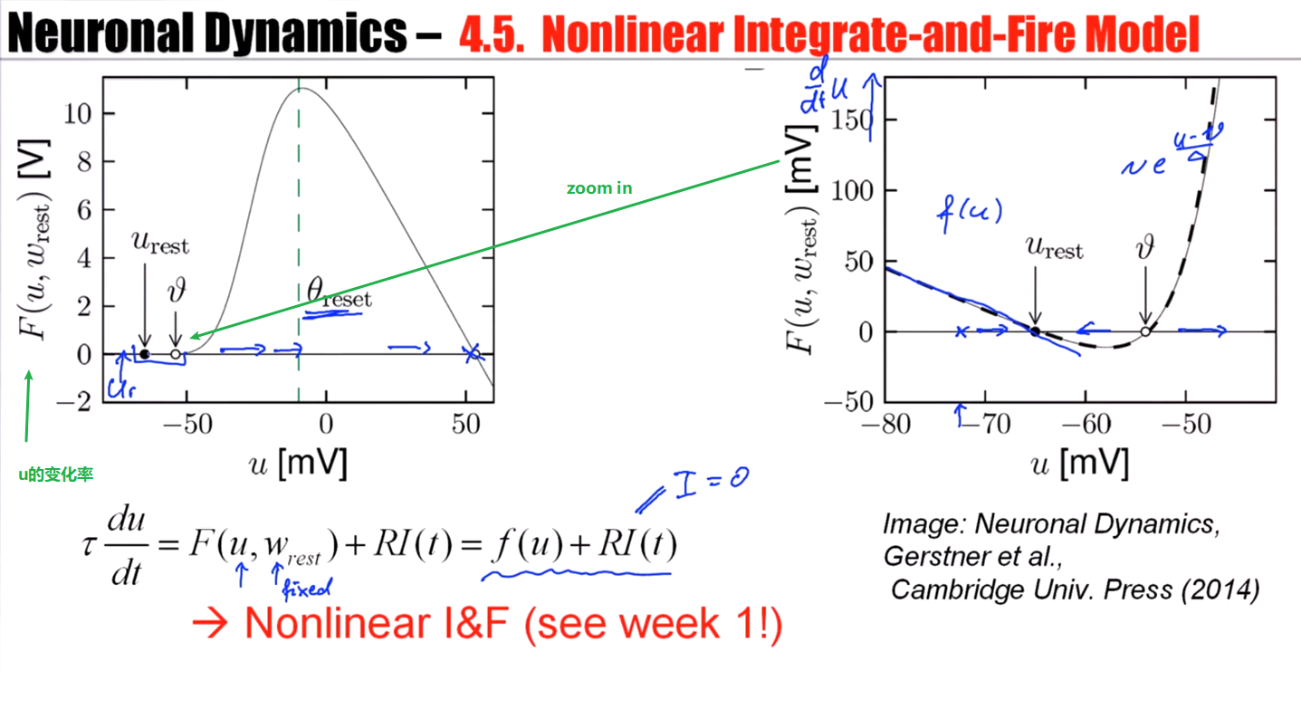

Slide 26
Neuronal Dynamics – 4.5. Nonlinear Integrate-and-Fire Model
Exponential integrate-and-fire model
(EIF)
Image: Neuronal Dynamics,
Gerstner et al.,
Cambridge Univ. Press (2014)
→ Nonlinear I&F (see week 1!)

Slide 27
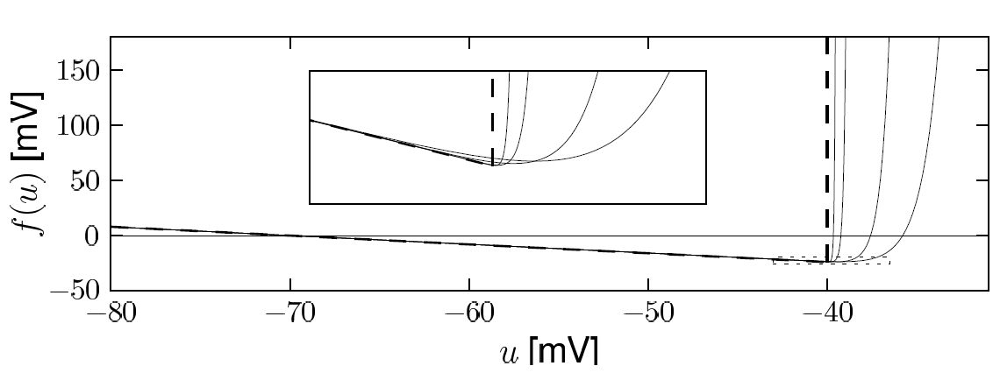
Neuronal Dynamics – 4.5. Exponential Integrate-and-Fire Model
Exponential integrate-and-fire model (EIF)
linear
Image: Neuronal Dynamics,
Gerstner et al.,
Cambridge Univ. Press (2014)

Slide 28
Neuronal Dynamics: Computational Neuroscience of Single Neurons
Nonlinear Integrate-and-Fire Model
Nonlinear Integrate-and-fire (NLIF)
- Definition
- quadratic and expon. IF
- Extracting NLIF model from data
- exponential Integrate-and-fire
- Extracting NLIF from detailed model
- from two to one dimension
- Quality of NLIF?
Week 1 and Week 4:
Nonlinear Integrate-and-fire Model
Wulfram Gerstner
EPFL, Lausanne, Switzerland

Slide 29
Neuronal Dynamics – 4.5 sparse activity in vivo
Spontaneous activity in vivo
awake mouse, cortex, freely whisking,
-spikes are rare events
-membrane potential fluctuates around ‘rest’
Crochet et al., 2011
Aims of Modeling: - predict spike initation times
- predict subthreshold voltage

Slide 30
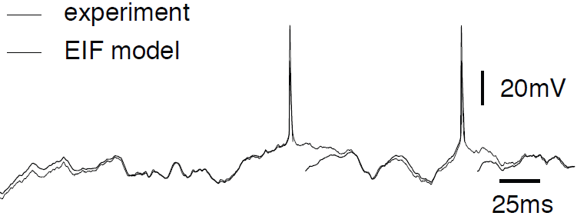
Neuronal Dynamics – 4.5.How good are integrate-and-fire models?
Badel et al., 2008
Aims: - predict spike initation times
- predict subthreshold voltage
Add adaptation and
refractoriness (week 7)
Notes:
It's only during the phase after the spike where we expect that additional processes come into play. That exponential integrate-and-fire model is not as good. But if you add adaptation and refractoriness, as we will do in week seven, then this part can be covered as well.

Slide 31
Neuronal Dynamics – 4.5. Exponential Integrate-and-Fire Model
Direct derivation from Hodgkin-Huxley
Fourcaud-Trocme et al, J. Neurosci. 2003
gives expon. I&F

Slide 32
Neuronal Dynamics – 4.5. Nonlinear Integrate-and-Fire Model
2-dimensional equation
Separation of time scales
w is constant (if not firing)
Relevant during spike
and downswing of AP
threshold+reset for firing

Slide 33
Neuronal Dynamics – 4.5. Nonlinear Integrate-and-Fire Model
2-dimensional equation
Separation of time scales
w is constant (if not firing)
Linear plus exponential

Slide 34
Neuronal Dynamics – Quiz 4.7.
Exponential integrate-and-fire model.
The model can be derived
[ ] from a 2-dimensional model, assuming that the auxiliary variable w is constant.
[ ] from the HH model, assuming that the gating variables h and n are constant.
[ ] from the HH model, assuming that the gating variables m is constant.
[ ] from the HH model, assuming that the gating variables m is instantaneous.
B. Reset.
[ ] In a 2-dimensional model, the auxiliary variable w is necessary to implement a
reset of the voltage after a spike
[ ] In a nonlinear integrate-and-fire model, the auxiliary variable w is necessary to implement a reset of the voltage after a spike
[ ] In a nonlinear integrate-and-fire model, a reset of the voltage after a spike is implemented algorithmically/explicitly

Slide 35
Neuronal Dynamics – Nonlinear Integrate-and-Fire
Reading: W. Gerstner, W.M. Kistler, R. Naud and L. Paninski,
Neuronal Dynamics: from single neurons to networks and
models of cognition. Chapter 4: Introduction. Cambridge Univ. Press, 2014
OR W. Gerstner and W.M. Kistler, Spiking Neuron Models, Ch.3. Cambridge 2002
OR J. Rinzel and G.B. Ermentrout, (1989). Analysis of neuronal excitability and oscillations. In Koch, C. Segev, I., editors, Methods in neuronal modeling. MIT Press, Cambridge, MA.
Selected references.
-Ermentrout, G. B. (1996). Type I membranes, phase resetting curves, and synchrony.
Neural Computation, 8(5):979-1001.
Fourcaud-Trocme, N., Hansel, D., van Vreeswijk, C., and Brunel, N. (2003). How spike generation mechanisms determine the neuronal response to fluctuating input.
J. Neuroscience, 23:11628-11640.
Badel, L., Lefort, S., Berger, T., Petersen, C., Gerstner, W., and Richardson, M. (2008). Biological Cybernetics, 99(4-5):361-370.
- E.M. Izhikevich, Dynamical Systems in Neuroscience, MIT Press (2007)

